Slide 1
Mission Control Center
Rasmus Stougaard
Department of Control Engineering,
Aalborg University, Denmark
Notes:
State what i will tell

Slide 2
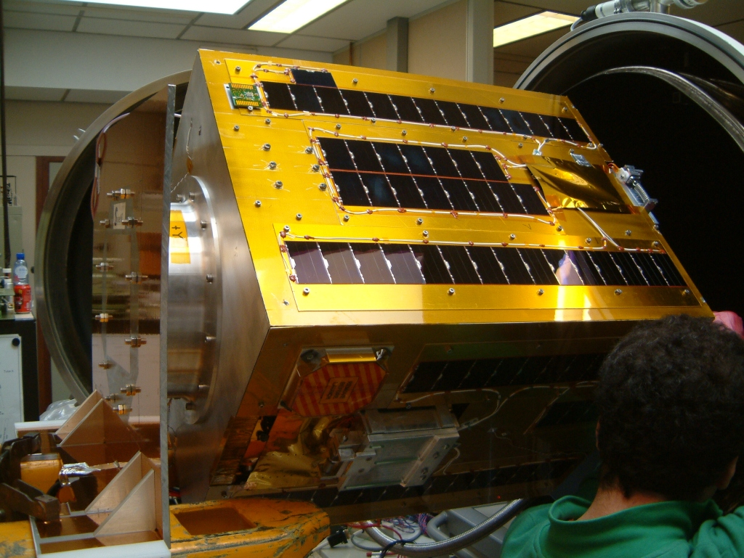
Background
The Mission Control Center is part of two student satellite projects.
  AAUSAT-II.
  SSETI Express.
Notes:
Houston we have a problem
1 kg pico satellite following the Cubesat concept
Developed students here at Aalborg University
80 kg micro satellite
Student Space Exploration & Technology Initiative Express
Initiated by the European Space Agency
Collaboration between students from various universities in europe
The operations group is situated in poland therefore the MCC is distributed through the Internet

Slide 3
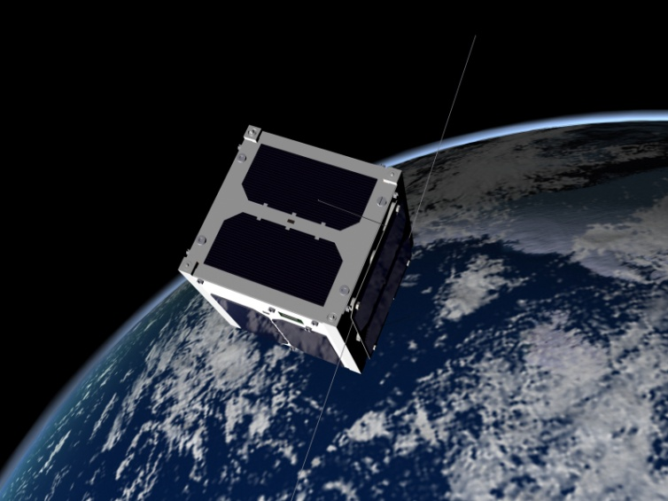
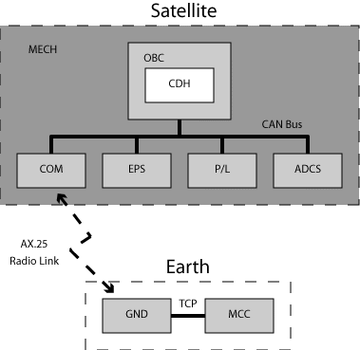
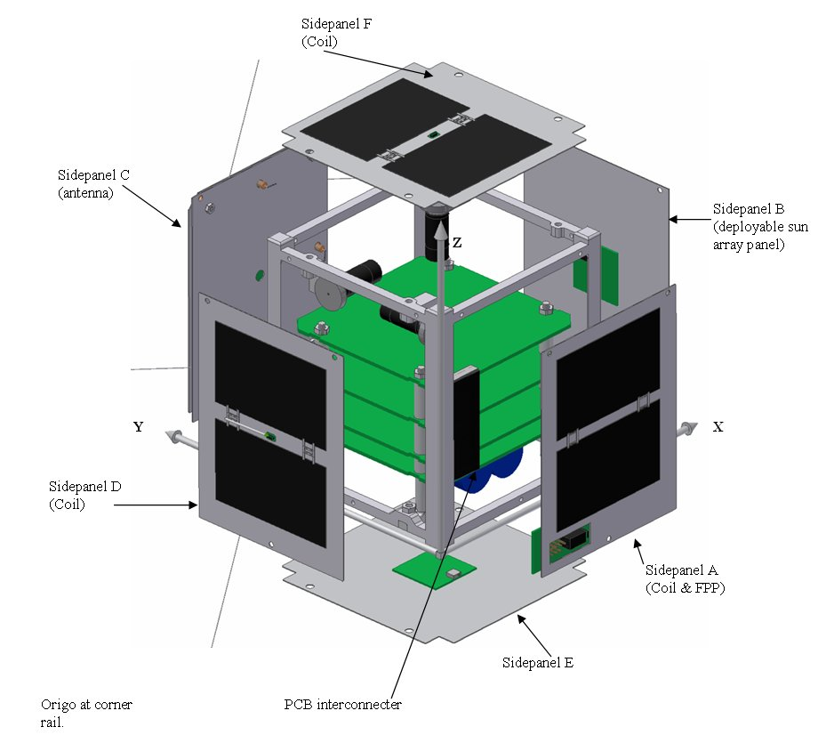
AAUSAT-II
Notes:
Dsri -> danish national space center
Attitudekontrol: forklares m modellen i hånden
1 kg student satellite
CubeSat 10 x 10 x 10 cm
Expected Launch December 2005
AAUSAT-II mission
Education
Gamma burst detection (DNSC)
Active attitude control
Deployment of solar arrays

Slide 4
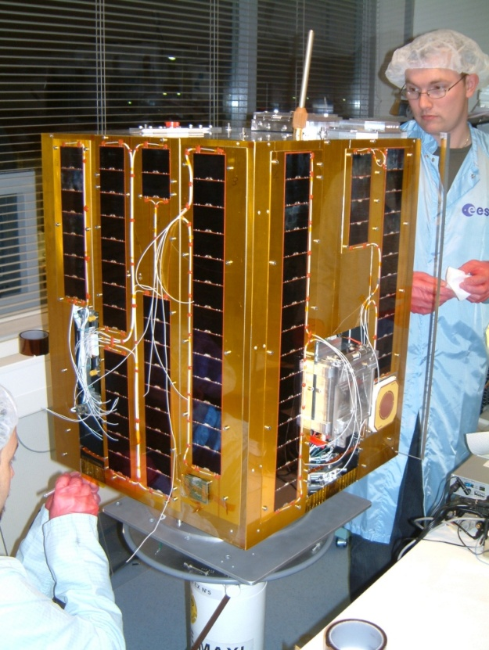

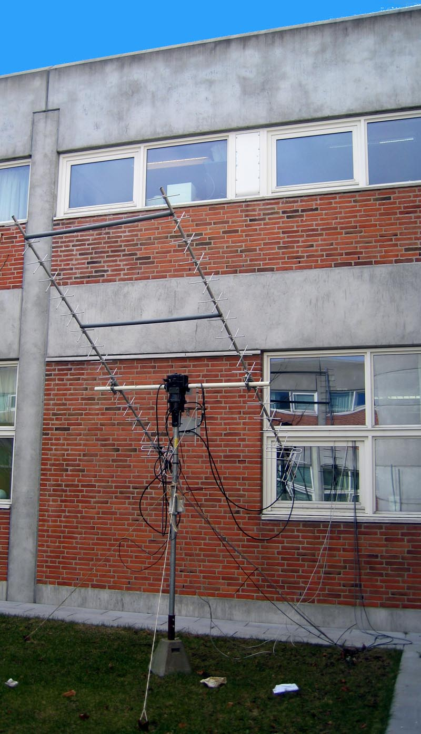
SSETI Express
Notes:
80 Kg micro satellite
Two ground stations
GND Aalborg
GND Svalbard (KSAT)
Operations group in Poland

Slide 5
SSETI Subsystems

Slide 6
Mission Control Center
Notes:
What is it good for?
Satellite in orbit
Ground stations (radio + antenna equipment) aalborg + svalbard
Operators in poland (express mission) controling the satellite mission
Data viewers are people interested in telemetry, that is data from the satellites
The MCC is the interface between the operators, data viewers, and the ground stations affiliated with the mission
The mission control center design comprises:
An operator interface , alows an operatore to issue TC ->
indernet -> mission control server hanles communication with satellite and stores data in the affiliated DB ->
database -> … -> dvi

Slide 7
MCC Technology
Java v. 1.5.0
MySQL
Debian Linux
Predict
Notes:
Platform independent
Open source – free – complies with student budget
NORAD

Slide 8
MCC States
Notes:
Forklar de enkelte states:
- direct control full manual control to the operator (e.g. no retransmission)
- nominal mode
- idle doesn’t do much
- flight plan, sequential program
Hvordan/hvornår skiftes
Forklar grundideen m fligthplans
Override state kan tilgås på et vilkårligt tidspunkt

Slide 9
Database Design
MCC facilitates online definition of tele commands and telemetry.
Database design is built upon the protocol for SSETI Express.
Both data and definitions are stored in the database.
Notes:
At the begining of the MCC project Express subsystems was not completed
Telecommands and telemetry should be defined online, to allow development of the MCC
The protocol structure was defined
A database facilitating the use of the protocol structure was designed
Der er både data og definitioner af dataformater/betydning i databasen.

Slide 10
Data Distribution

Slide 11
Live Demo ☺

Slide 12
Conclusion
Platform independent
Providing an easy to use interface for mission control
Multiple ground station support (more can be added)
Abstraction from the satellite communications protocol
Gathering and processing of satellite telecommands and telemetry
Suggestion
  Data structure modelling feature
  Standard communication protocol

Slide 13
MCC Team
Contact:
04gr733@control.aau.dk

