Slide 1
Generic Ground Station
- for Mission Control Center
Claus Nielsen
cnie02@space.aau.dk
Department of Control Engineering,
Intelligent Autonomous Systems
Aalborg University, Denmark

Slide 2
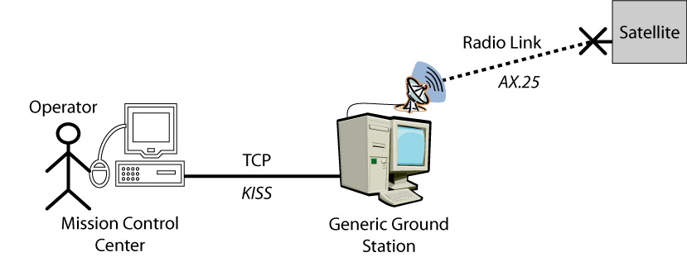
Purpose
Create communication between the Mission Control Center and the satellites, SSETI Express and AAUSAT-II
Should be duplicated and placed at
  Aalborg University
  Svalbard in Norway
  Copenhagen University College of Engineering
Design software for standard hardware
Notes:
Communication Pipe between MCC and the satellite
The hardware used in Aalborg is just what we had,
Several Ground stations are to be placed at Svalbard and in Copenhagen. Both places have different hardware from the hardware used in Aalborg
Therefore the software is designed independent on the hardware, but using a general hardware setup
The operator uses the Mission Control Center which sents the data to a GND over the internet using a KISS protocol
GND then transmits the data on a radio link to the satellite using the AX.25 protocol connection less since same frequency is used for up and down load.
Not using full AX.25 but only what is needed. AX.25 USED so radio amateurs may also communicate with the satellite.

Slide 3
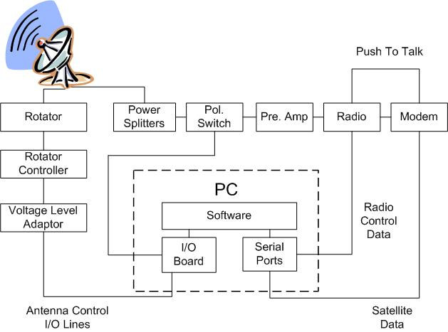
Hardware Overview
Hardware used at Aalborg University
  2xYagi antennas: Wimo WX-7036
  Rotator: Yaesu G-5500
  Radio: ICOM 910H
  Modem: CMX469A MSK/FFSK (AAUSAT-II) TNC-7 FSK 9k6 baud (SSETI Express)
Notes:
The hardware consists of two parts, antenna control and the communication path
An I/O board is used for controlling the Antenna using a rotator and a rotator controller.
Communication is the modem into the radio through a preamplifier, a polarization switch and into the power splitters.
S-Band not fully implemented yet.

Slide 4
Software Overview
Antenna Control
  Makes the antenna point in the right direction by using TLE for the satellite from CelesTrak as input for Predict
Communication Control
  Sets the correct frequencies on the radio
  Encodes and decodes the protocols
Notes:
Predict is running as a server on the GND computer and a client in the software uses the TLE for a satellite to get informations like the dopller shift´, the direction of the antenna and things like that.

Slide 5
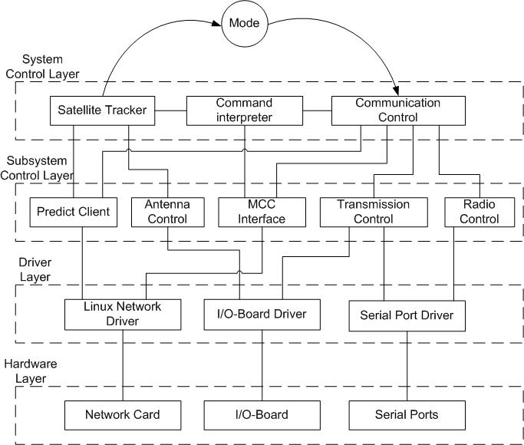
Software Overview
Notes:
The software is split into 4 layers to simplify the design of the sofware. Each layer consists of several modules that takes care of simple tasks.
This makes it easy to fit the software for more hardware. And the software may be used for more kind of satellites.

Slide 6
Software Overview
Hardware Layer
  Interfaces to Mission Control Center, the radio, the modem and the rotator controller.
Driver Layer
  Sends and receives data from the hardware to the higher layers in the software

Slide 7
Software Overview
Subsystem Control Layer
  Simple interfaces to drivers
    Predict Client – Gets information from Predict Server
    Antenna Control – Controls antenna
    MCC Interface – Communicates with Mission Control Center
    Transmission Control – Controls when the radio is ready
    Radio Control – Controls the radio
System Control Layer
  Creates cooperation between all modules
  Controls which mode the ground station is in
  Decodes commands from Mission Control Center
  Controls when to communicate with the satellite

Slide 8
Software Overview
Modes
  Out of Range Waiting – No satellite to track
  Out of Range Moving – Moving into position
  Out of Range Ready – Waiting for satellite
  In Range Moving – Moving into position
  In Range Tracking – Communicating
Notes:
The software consists of 6 threads which each takes care of simualtanious tasks.
The modes describes what the state of the gnd is

Slide 9
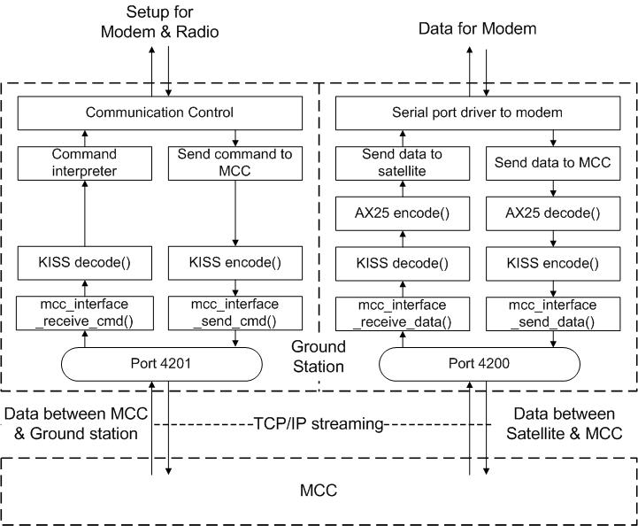
Software Overview
Data Communication

Slide 10
Results
To be used for AAUSAT-II and SSETI Express
  Primary placed at Aalborg University – Linux
  Secondary placed at Svalbard in Norway – Windows
  Copenhagen University College of Engineering – Linux
  Written in ANSI C - Easy to port to different OS
  All have different hardware
  All GND places have different hardware – only drivers needs to be changed

Slide 11
Results
Tested with SSETI Express at ESTEC
  Mission Control Center through Ground Station to the Onboard Computer
Downloaded data from other satellites in space with same specifications
  Quakesat, GO-32, AO-51...
Notes:
GND is not completely generic as parts of the software regarding the protocols has been designed specific for SSETI Express and AAUSAT-II
But the design makes it possible to use the design as a basis for further work
GND has been tested as data has been received from satellites in space with almost the same properties, and also with MCC and SSETI Express at ESTEC

Slide 12
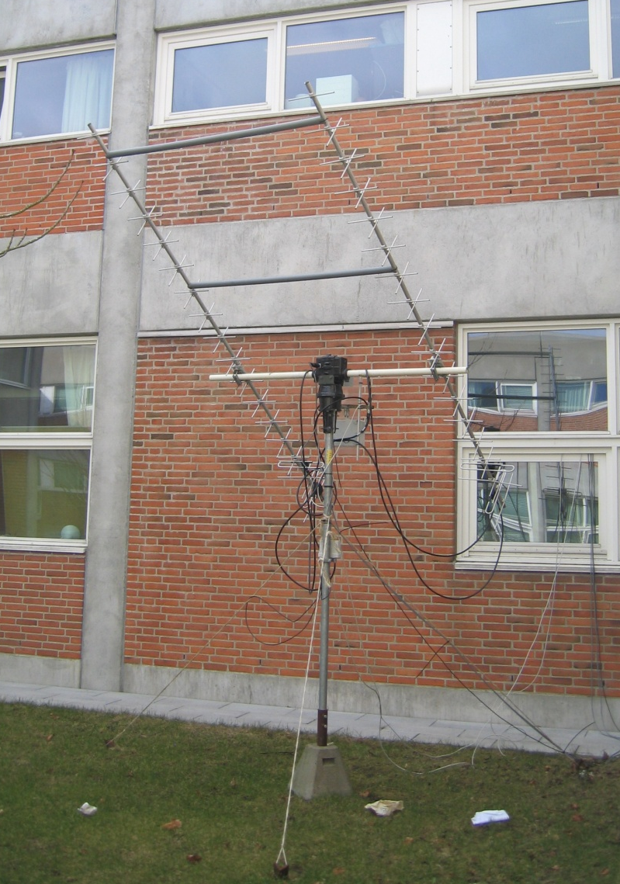
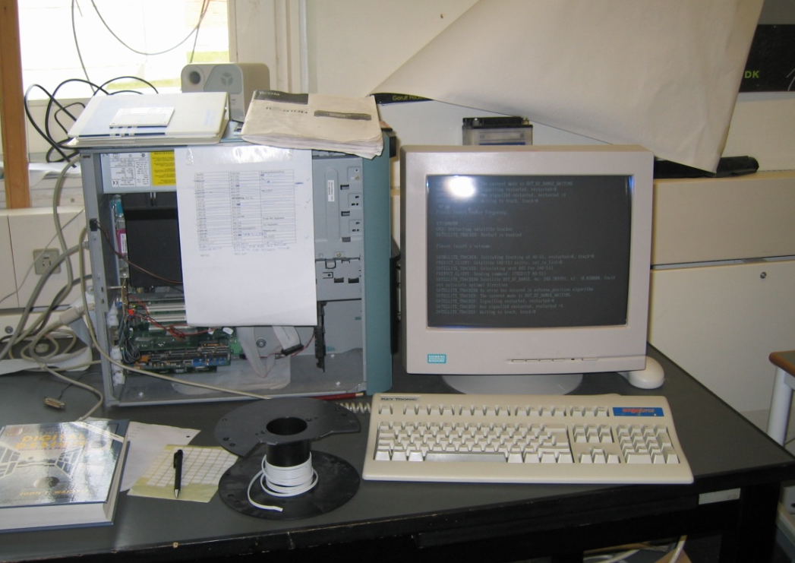
Ground Station at Aalborg
Notes:
GND is not completely generic as parts of the software regarding the protocols has been designed specific for SSETI Express and AAUSAT-II
But the design makes it possible to use the design as a basis for further work
GND has been tested as data has been received from satellites in space with almost the same properties, and also with MCC and SSETI Express at ESTEC

Slide 13
Future
Final test
  When SSETI Express is launched
Placing Generic Ground Stations all over the world would improve communication time
Use same Ground Station for several satellites
Notes:
GND is not completely generic as parts of the software regarding the protocols has been designed specific for SSETI Express and AAUSAT-II
But the design makes it possible to use the design as a basis for further work
GND has been tested as data has been received from satellites in space with almost the same properties, and also with MCC and SSETI Express at ESTEC

