Slide 1
Communication System for the AAUSAT-II
Kresten K. Sørensen
kkso02@space.aau.dk
Department of Control Engineering
Aalborg University

Slide 2
AAUSAT-II Mission Objectives
Education
Communication
(One-way and two-way)
Attitude Determination & Control System
(Detumbling and pointing)
Payload (Gamma Ray Detector)
Deploy extra solar panels
Upload new software for radio amateur use

Slide 3
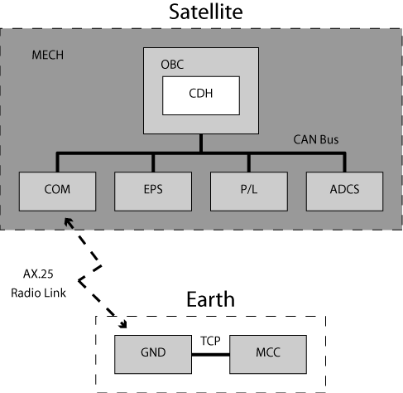
AAUSAT-II Overview
MECH - Mechanical structure
OBC – Onboard Computer
CDH – Command Data Handler
COM – Communication
EPS – Electrical Power Supply
P/L – Payload
ADCS – Attitude Determination and Control System
GND – Ground station
MCC – Mission Control Center
Notes:
To have all of you to understand how the AAUSAT-II is designed I will start with explaining the subsystems included in this project.
First of all we have the mechanical structure which must fit the demands for a cubesat to be 10 times 10 times 10 cm and a mass at 1 kg.
Next thing is the onboard computer which is the hardware som og the subsystems use for their software to run on.
This is first of all the Command data handler, which takes care of the superior control of the satellite like deciding which subsystems are allowed to run and make sure the satellite is behaving the way it should be. CDH also collects the housekeeping data for all subsystems so they can be send to the earth on a request.
The Payload onboard the satellite is a gamma ray detector which can be used for measuring radiation in space.
The Attitude Determination and Control system shall detumble the satellite and test attitude control of a cubesat using magnetorquers and momentum wheels.
Both P/L and ADCS have a thread running on the OBC
EPS is the Electrical power supply which shall deliver power to the satellite using solar cells.
Finally the Communication system sends and receive data from the ground station and pipes the data directly through to CDH on the CAN bus. COM also sends the basic beacon.
All communication between the subsystems uses the CAN bus
On the earth it is possible to send a flight plan from the Mission COntrol Center. The MCC then sends the data to the ground station which then transmits the telemetri to the satellite, when a pass is present.
The first 6 month of operation AAUSAT-II is used to verify the mission objectives. After that new software will be uploaded and radio amateurs will be able to communicate with it according to telecommands which will be published at that time

Slide 4
COM System
Purpose
To create a communication path between the satellite and Earth.
Demands
Simple, robust design
Power saving
Small
Interface to: CAN, RS232, and Radio

Slide 5
Block Diagram
Components
MCU
Radio
CAN
UART
Modem

Slide 6
Specifications for COM 1/2
Radio Frequency: 437.425 MHz (Half duplex)
6 kHz bandwidth
Data rates: 1200/2400/4800 bit/sec
FFSK/MSK-modulation
Transmitter Power: 0.5 W
Link budget: (Worst case)
Downlink margin 6,2 dB
Uplink margin 20,5 dB
CAN bus: 125 kbps
Notes:
The radio link is half duplex at 437.425 MHz
The CAN Bus is 125 kbps
A mass of 110 gram (10% of 1 kg) Depends on the Antenna the KOM department comes up with
All components on COM uses 3.3 V which gives a power consumption of almost 200 mW when the radio is listening and 300 when receiving, while 2 Watt is used when transmitting.
Data rates at 1200 2400 and 4800 baud can be set by sending a command from MCC which then will be veified before data is transmitted at the selected baudrate. 1200 baud is standard when COM reboots.

Slide 7
Specifications for COM 2/2
Mass incl. Antenna: 110g
Supply voltage: 3.3 V
Power Consumption
Listening: 184.8 mW
Receiving: 283.8 mW
Transmitting: 2085.6 mW
Notes:
The radio link is half duplex at 437.425 MHz
The CAN Bus is 125 kbps
A mass of 110 gram (10% of 1 kg) Depends on the Antenna the KOM department comes up with
All components on COM uses 3.3 V which gives a power consumption of almost 200 mW when the radio is listening and 300 when receiving, while 2 Watt is used when transmitting.
Data rates at 1200 2400 and 4800 baud can be set by sending a command from MCC which then will be veified before data is transmitted at the selected baudrate. 1200 baud is standard when COM reboots.

Slide 8
Modulation options
FSK - Frequency Shift Keying
MSK - Minimum Shift Keying
GMSK - Gaussian Minimum Shift Keying

Slide 9
MSK Modulation
Advantages of MSK modem
Good noise performance compared to FSK
Easy to use
Disadvantages for MSK modem
Synchronous interface
Synchronization
Data must be synchronized to clock
The modem synchronize automatically on bit level
Synchronization on byte level must be done in software on the MCU

Slide 10
Clock Divider
Adds the possibility of bit rates down to 150 bps by dividing the data clock with 1, 2, 4 or 8
Gives more than one symbol per bit and makes the signal easier to demodulate.

Slide 11
Basic Beacon
Basic Beacon format: AAUSATII <data>
AAUSATII sent as Morse code on FM
An 800 Hz Morse tone is sent to the radio
Makes it easier to find the satellite
Morse tone created with the MCU PWM generator and a low-pass filter
Data is modulated by the modem
6 bit battery voltage + 2 bit counter
After low-pass filter

Slide 12
Protocol
Connectionless AX.25 using UI frames
Flags used for synchronization
Header for identification of packets
Checksum for verification of packet contents
Connection orientated AX.25 is to difficult to implement considering our demands
The connection orientation is placed on a higher level on the OBC and GND server.

Slide 13
Software
Software tasks
Relay data between GND and CDH
Send basic beacon
Collect housekeeping data
Interfaces
CAN bus
USART for modem and radio
UART for GND segment and debugging
Notes:
Sende data frem og tilbage mellem GND og CDH.
Grænseflader ud til de andre subsystemer og komponenter

Slide 14
Software Structure
Interrupt module
External communication functions
Time critical functions
Main module
Internal functions
Non time critical functions

Slide 15
Synchronization
Synchronous bit stream without start and stop bits
Hardware synchronization difficult
The AX.25 flag is used for synchronization
Synchronization is done by the ISR
CD
101111001001111110011111100111111001
ISR sync.

Slide 16
Pictures – Radio prototype

Slide 17
Pictures – Modem prototype

Slide 18
Pictures – Modem prototype

